Slide 1
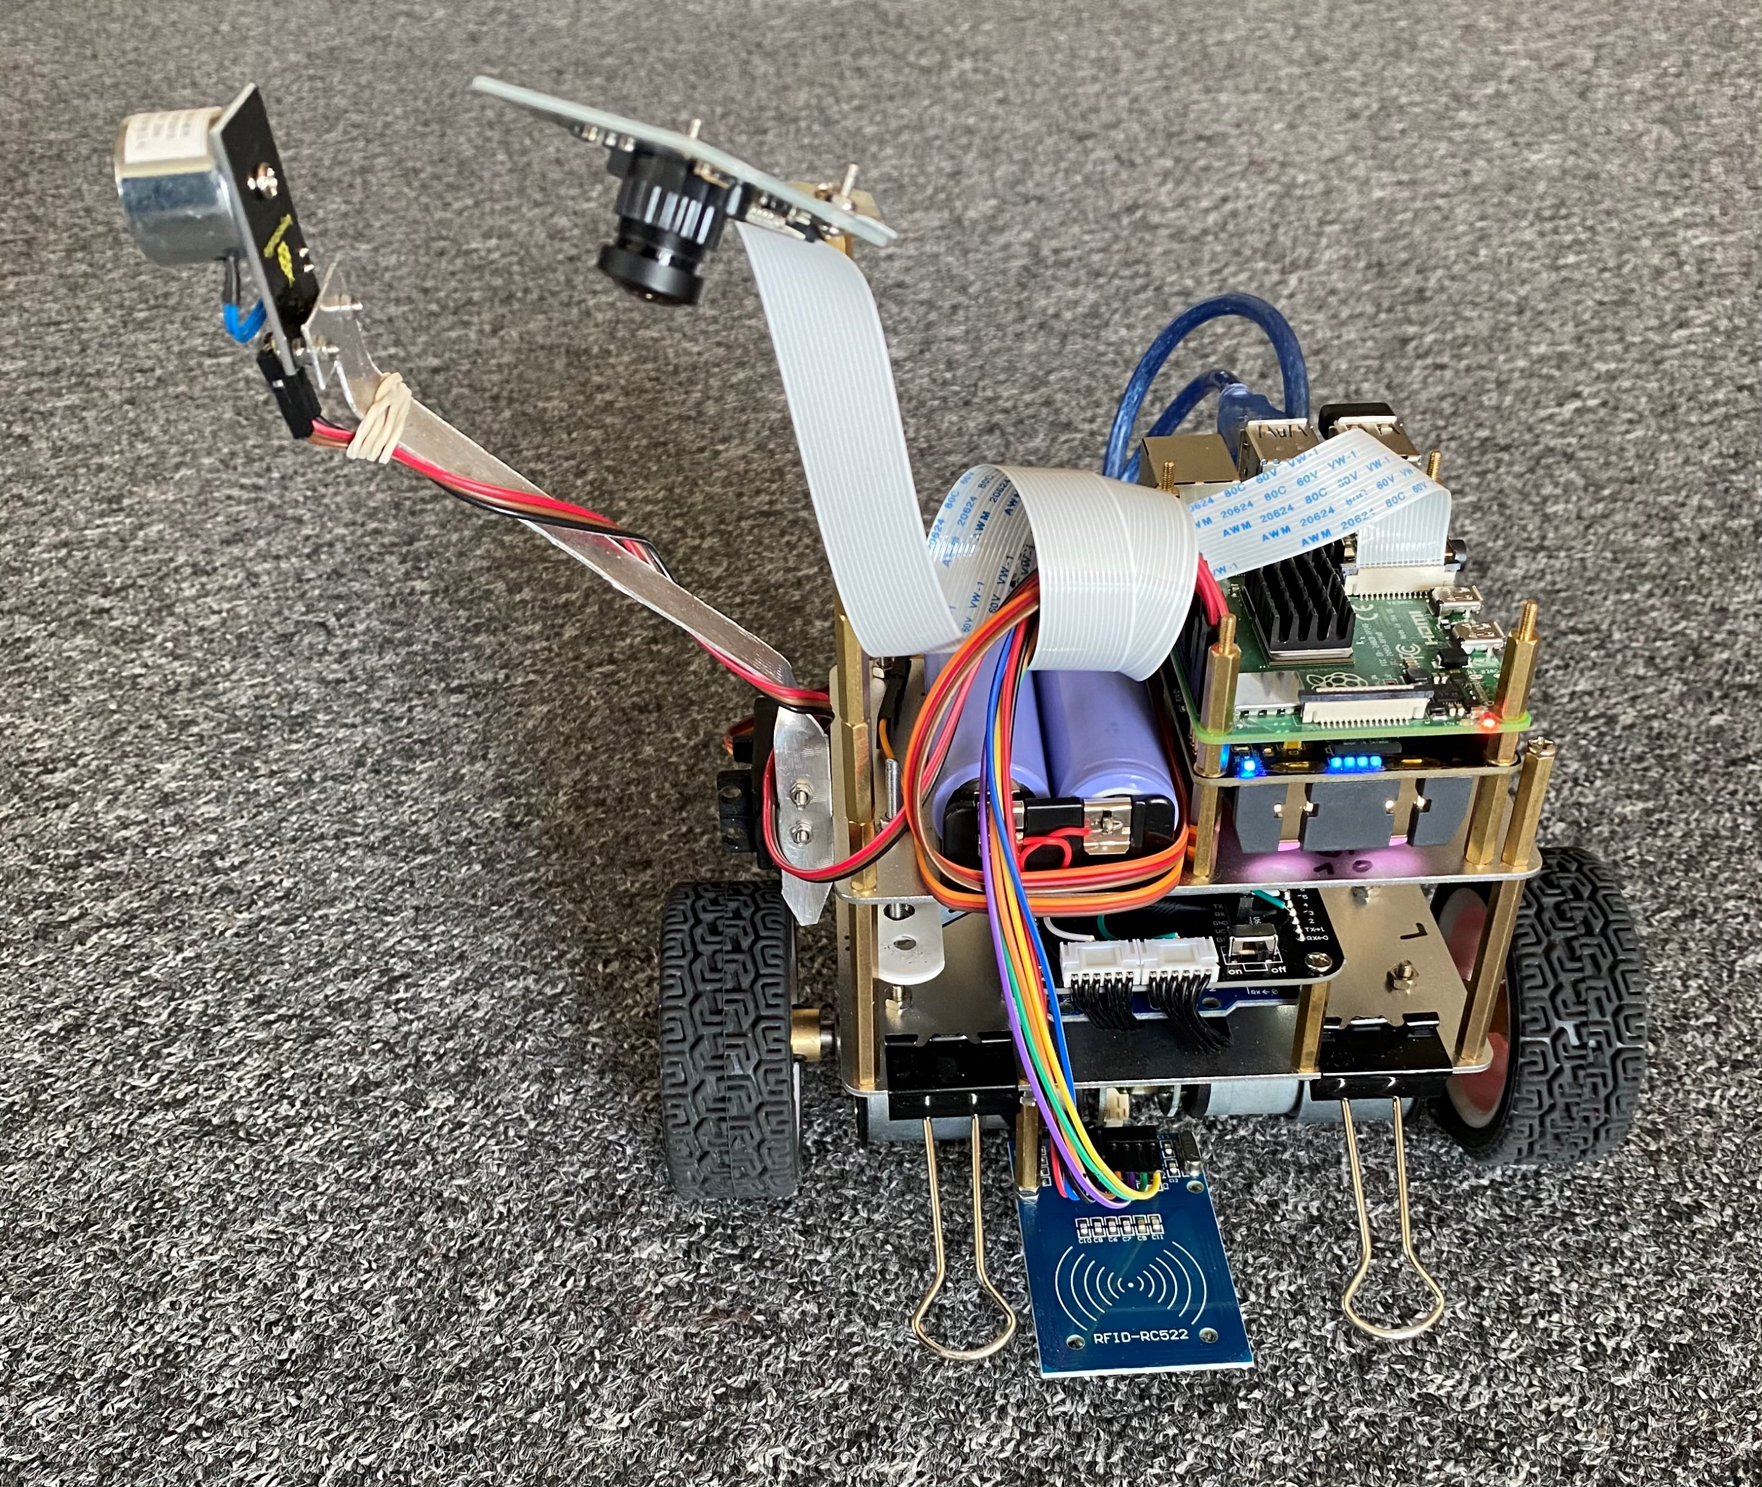
Overview of the hardware set-up of the 2-wheeled, self-balancing robot
wide-angle camera
electro-magnet
Raspberry Pi 4B
Servo
power sources
power sources
motors & angle sensors
accelerometer & gyro board
RFID reader
Arduino
R. Bruckmeier, https://github.com/robbruck/RFID-robot

